Slide 1
ENGT 4050
Senior Technology Capstone
Spring 2014
Team B-12

Slide 2

Code TA
Team B-12
Brandon Collins, Team Leader
Stephen Wambui
Sierra Linn
Ben Morris

Slide 3

Outline
Background and Motivation
Summary
Details
  Scope and Elements
  Deliverables
  Challenges
  Timeline
  Budget
Conclusion
Questions

Slide 4
Background and Motivation
Increased demand for technical and computer-based careers
Increased professor workload
A TA can provide support
Can the process be automated?

Slide 5
Summary
Web-based application
Organize assignments, students, etc.
Upload and automatically grade code
Improves:
  Professor efficiency
  Student feedback

Slide 6
Scope and Elements
Small, but scalable
  Modular
  Linux server
Github
Four elements:
  Web front-end
  Web back-end
  Database
  Server-side grading program

Slide 7
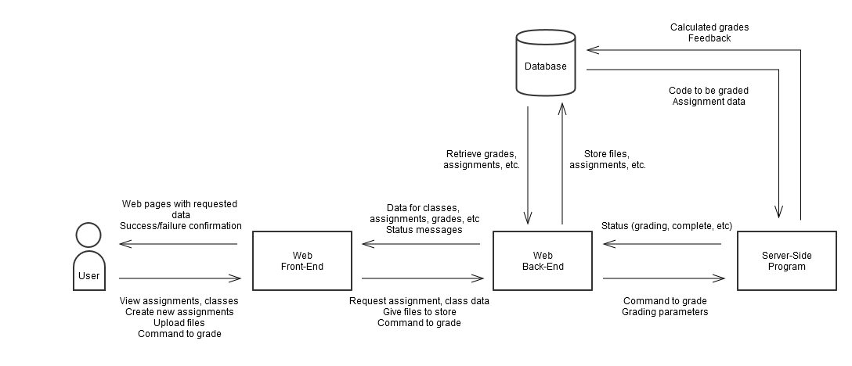
Scope and Elements

Slide 8
Deliverables
Website
  Front-end
  Back-end
Database
Server-side grading program

Slide 9
Deliverables
Website
  Front-end
    Everything the user sees
    Direct interaction
    Built with:
      HTML
      CSS
      Graphics

Slide 10
Deliverables
Website
  Back-end
    Interfaces with other elements
    Built with:
      Python-Flask

Slide 11
Deliverables
Database
  Collection of all user, class, assignment info
  Maintenance code
  Built with:
    PostgreSQL
    Python (maintenance code)

Slide 12
Deliverables
Server-side grading program
  Compiles code
  Runs code
  Evaluates code
  Built with:
    Python

Slide 13
Challenges
Front-end
  User-friendly
  Multiple platforms
Database
  Simplicity
  Efficiency
Back-end, database maintenance, grading program
  Maintainability
  Scalability

Slide 14
Timeline
Database schema – 1 week
Web-end – 4 weeks
Database implementation – 1 week
Web back-end – 3 weeks
Server-side grading program – 4 weeks
Database management and support code – 2 weeks
User testing – 2 weeks
Integration testing – 2 weeks

Slide 15
Timeline

Slide 16
Budget
Web hosting
  $5-$15/month
Domain name
  ~$10
Total estimated cost: $30-$70

Slide 17
Conclusion
Web-based grading application
Potential to improve professor efficiency
Modular
Scalable

Slide 18
Questions?

